Slide 1
Transportation
Soekarno Hatta Int. Airport → 35 KM to Venue
Transportation available :
Blue Bird Taxi : https://www.bluebirdgroup.com/mybluebird
Airport Train : https://www.jakarta.go.id/railink
Gocar and Grabcar
Halim Perdana Kusuma Dom. Airport → 11 KM to Venue
Transportation available :
Taxi
Gocar and Grabcar

Slide 2
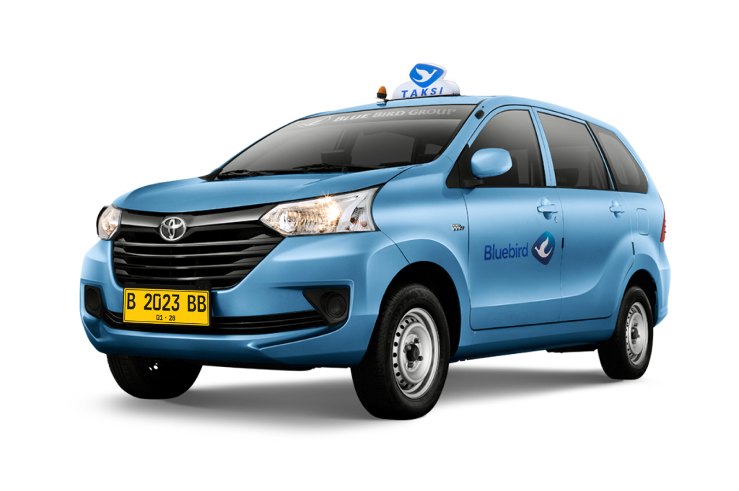
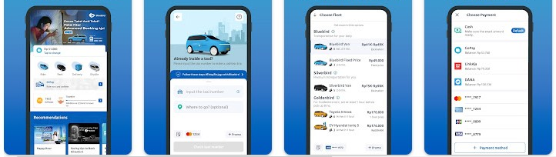
Airport Transfer
Transportation Around Jakarta
Prepared by :
After exiting the terminal, participant can find Blue Bird Taxi Queue
Blue Bird dispatcher will assist on ordering the unit until participant get on the vehicle.
Download MyBluebird apps from Play Store or App Store
Click on ‘GoCar’ to order the car
Type in the destination
Choose fleet
Choose type of payment
Click ‘Order’

Slide 3
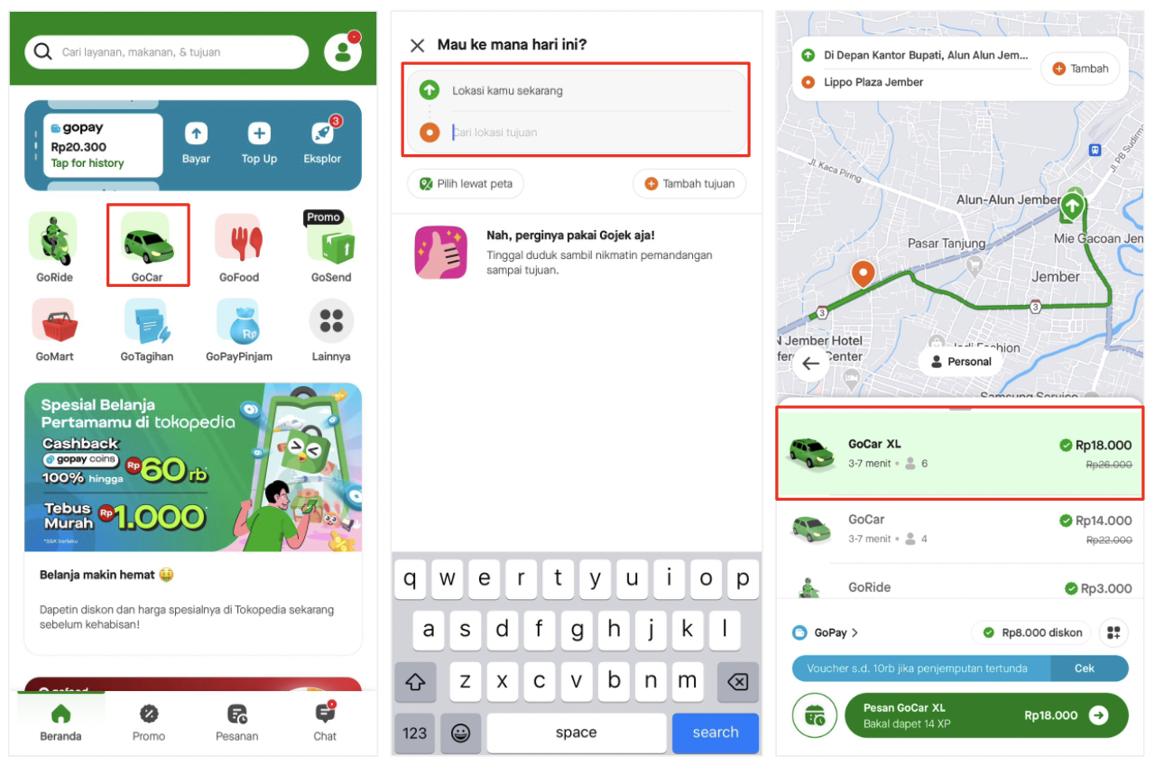
Transportation around Jakarta - GoCar
Prepared by :
Download GoJek application from Play Store or App Store
Click on ‘GoCar’ to order the car
Type in the destination
Choose fleet
Choose type of payment
Click ‘Order/Pesan’
2
3
4
5
6

Slide 4
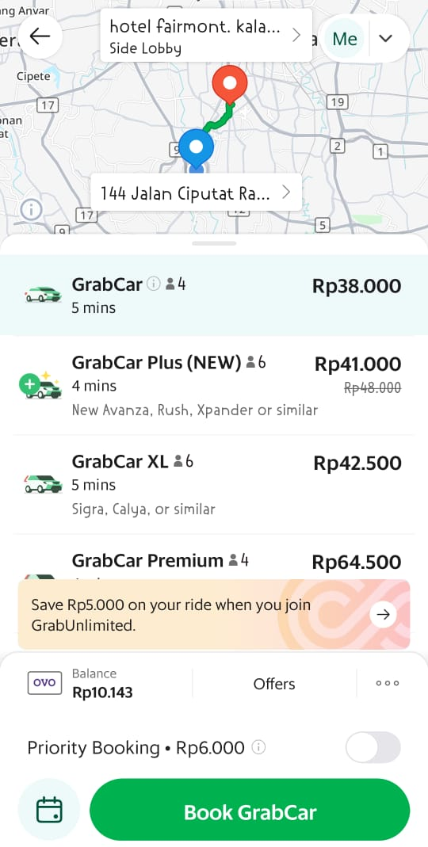
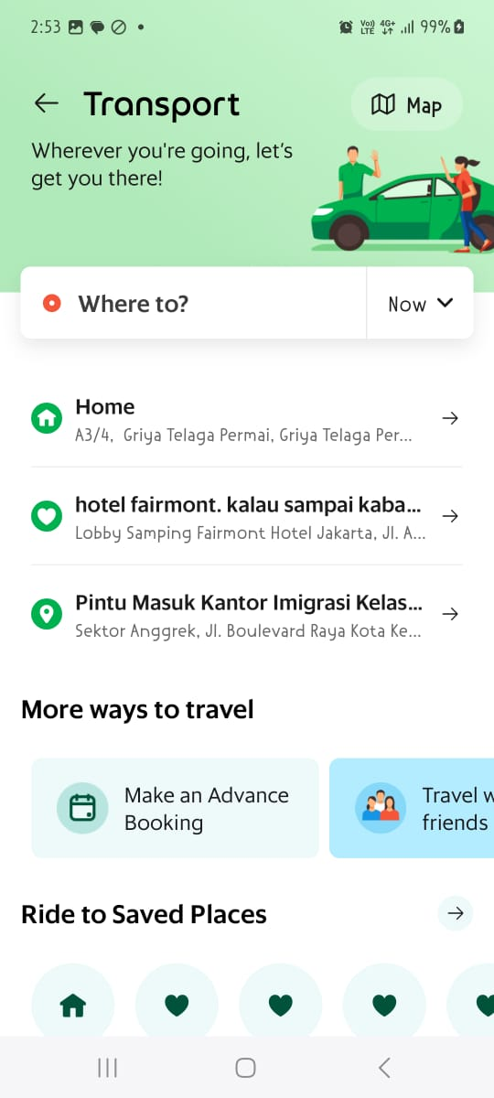
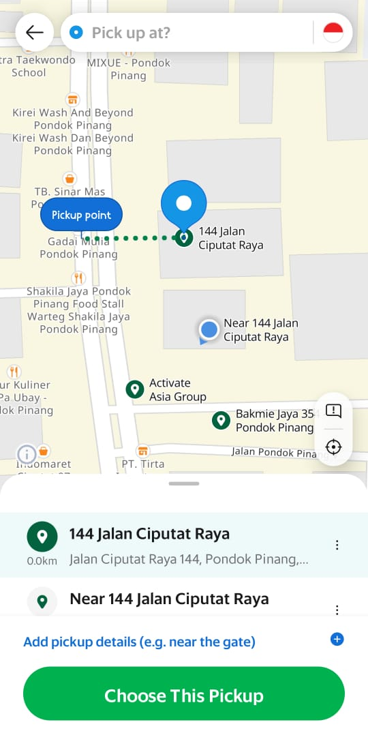
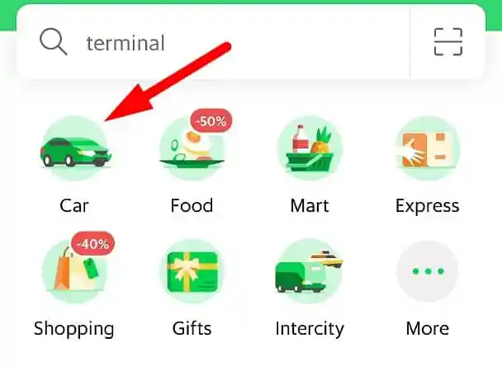
Transportation around Jakarta - Grab
Prepared by :
Download Grab application from Play Store or App Store
Click on ‘GoCar’ to order the car
Type in the destination, then mark your pick up spot
Choose fleet
Choose type of payment
Click ‘Order/Pesan’
4
2
3
5
6

